Slide 1
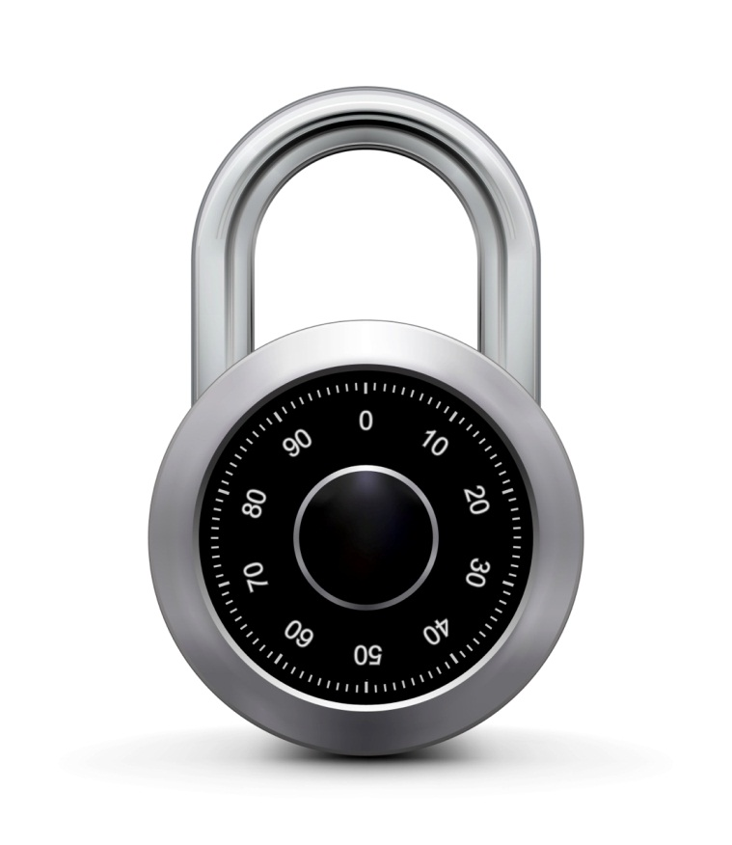
Modes of operation: many time key (CTR)
Online Cryptography Course Dan Boneh
Using block ciphers
Example applications:
1. File systems: Same AES key used to encrypt many files.
2. IPsec: Same AES key used to encrypt many packets.

Slide 2
Construction 2: rand ctr-mode
Let F: K × {0,1}^{n} ⟶ {0,1}^{n} be a secure PRF.
E(k,m): choose a random IV ∈ {0,1}^{n} and do:
msg
IV
m[0]
m[1]
…
m[L]
⊕
F(k,IV)
F(k,IV+1)
…
F(k,IV+L)
IV
c[0]
c[1]
…
c[L]
ciphertext
note: parallelizable (unlike CBC)

Slide 3
Construction 2’: nonce ctr-mode
msg
IV
m[0]
m[1]
…
m[L]
⊕
F(k,IV)
F(k,IV+1)
…
F(k,IV+L)
IV
c[0]
c[1]
…
c[L]
ciphertext
To ensure F(k,x) is never used more than once, choose IV as:
128 bits
IV:
nonce
counter
starts at 0 for every msg
64 bits
64 bits
Notes:
Max message length is 2^64 blocks.

Slide 4
rand ctr-mode (rand. IV): CPA analysis
Counter-mode Theorem: For any L>0, If F is a secure PRF over (K,X,X) then E_{CTR} is a sem. sec. under CPA over (K,X^{L},X^{L+1}).
In particular, for a q-query adversary A attacking E_{CTR} there exists a PRF adversary B s.t.:
Adv_{CPA}[A, E_{CTR}] ≤ 2⋅Adv_{PRF}[B, F] + 2 q² L / |X|
Note: ctr-mode only secure as long as q²L << |X| . Better then CBC !

Slide 5
An example
Adv_{CPA} [A, E_{CTR}] ≤ 2⋅Adv_{PRF}[B, E] + 2 q² L / |X|
q = # messages encrypted with k , L = length of max message
Suppose we want Adv_{CPA} [A, E_{CTR}] ≤ 1/2³² ⇐ q² L /|X| < 1/ 2³²
AES: |X| = 2¹²⁸ ⇒ q L^{1/2} < 2⁴⁸
So, after 2³² CTs each of len 2³² , must change key
(total of 2⁶⁴ AES blocks)

Slide 6
Comparison: ctr vs. CBC
 | CBC | ctr mode
uses | PRP | PRF
parallel processing | No | Yes
Security of rand. enc. | q^2 L^2 << |X| | q^2 L << |X|
dummy padding block | Yes | No
1 byte msgs (nonce-based) | 16x expansion | no expansion
(for CBC, dummy padding block can be solved using ciphertext stealing)

Slide 7
Summary
PRPs and PRFs: a useful abstraction of block ciphers.
We examined two security notions: (security against eavesdropping)
Semantic security against one-time CPA.
Semantic security against many-time CPA.
Note: neither mode ensures data integrity.
Stated security results summarized in the following table:
 | one-time key | Many-time key (CPA) | CPA and integrity
Sem. Sec. | steam-ciphers det. ctr-mode | rand CBC rand ctr-mode | later
Power
Goal

